Slide 1
IMAGE COMPRESSION
Dylan Greene
Kyle Gifaldi

Slide 2
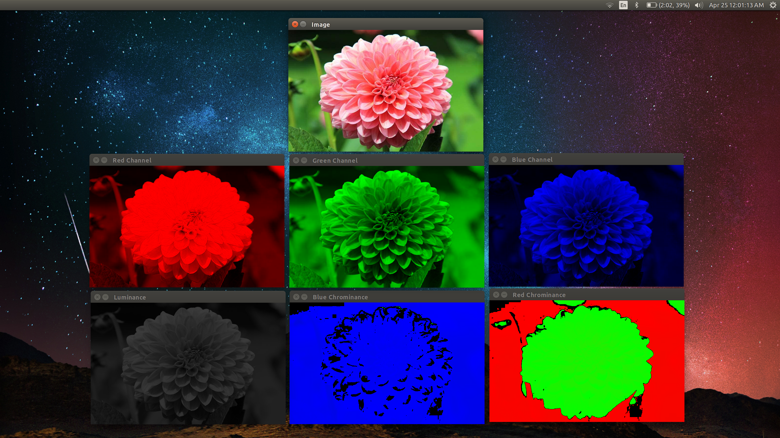
Why Image Compression?
Inspired by the show Silicon Valley
Data compression is powerful and prominent
Did not want to make a game
Wanted a challenge
Something we knew nothing about

Slide 3
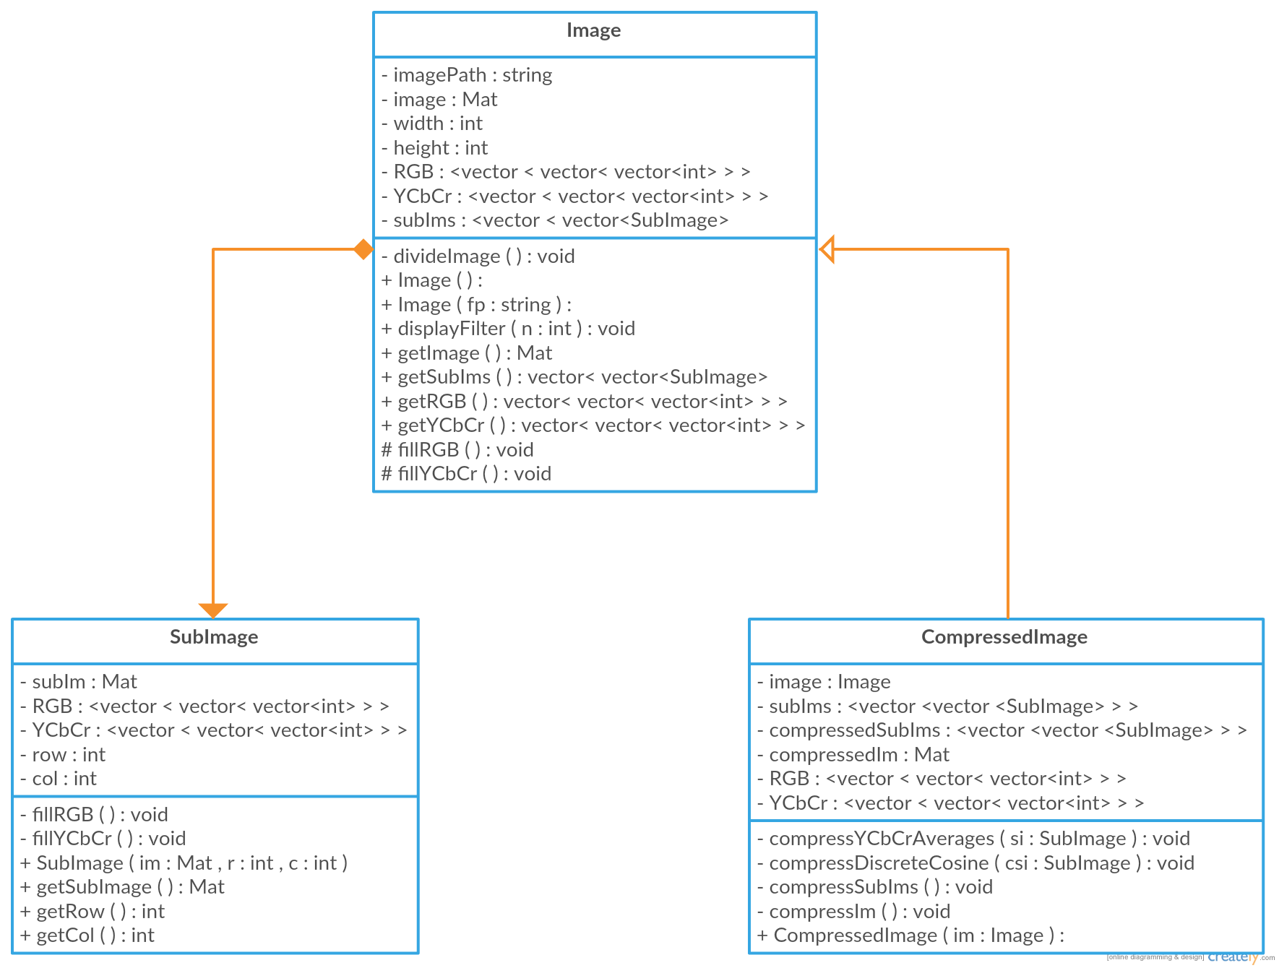
UML Diagram
Three classes so far
SubImage
Image
CompressedImage
Image is composed of SubImage objects
CompressedImage inherits from Image

Slide 4
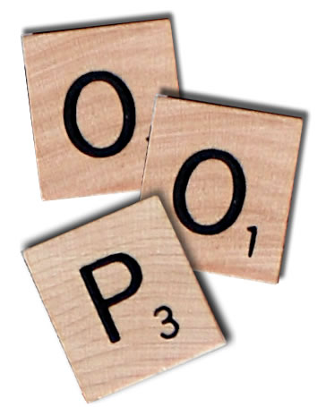
OOP!
Four main benefits of OOP for us:
Readability
Organization
Understanding
Data hiding
Git
Useful to have backups of code
Merge conflicts were time consuming

Slide 5
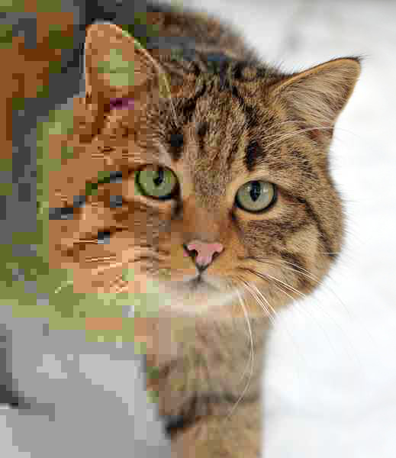
QUESTIONS?

